Slide 1
Using existing CCTV network for crowd management, crime prevention, and work monitoring using AIiML
PIP2001 Capstone Project
Review-1
Batch Number: CCS-G02
Under the Supervision of,
Dr. Vennira Selvi
Professor / Associate Professor / Assistant Professor
School of Computer Science and Engineering
Presidency University
Roll Number | Student Name
20211CCS0047 | Adithya R
20211CCS0066 | Greeshma Reddy
20211CCS0054 | Vignesh G
20211CCS0086 | Mohammad T
Name of the Program: B.Tech CSE (Cyber-Security)
Name of the HoD: Dr. Anandraj S P
Name of the Program Project Coordinator: Dr Sharmasth Vali
Name of the School Project Coordinators: Dr. Sampath A K / Dr. Abdul Khadar A / Mr. Md Ziaur Rahman

Slide 2
Content
Abstract
Literature survery
Objective and existing drawbacks
Proposed Method and Architecture
Timeline of the Project
References

Slide 3
Problem Statement Number: PCSC-71
Organization: Ministry of Railways
Category : Software
Problem Description:
The Indian Railways, one of the largest railway networks in the world, faces growing challenges in managing railway stations and trains due to increasing passenger numbers. Key issues include crowd management, cleanliness, crime prevention, and work monitoring. Traditional manual surveillance methods are time-consuming and prone to human error, leading to inefficiencies and missed incidents.
Integrating AI and ML technology into existing CCTV networks can enhance real-time monitoring, improve security, predict crowd patterns, and optimize resource allocation. However, implementing such a system requires significant investment in technology, infrastructure, and data management. Additionally, privacy and ethical concerns must be addressed to ensure responsible use of AI. Effective planning and execution are essential to maximize the benefits while maintaining passenger and worker rights.
Difficulty Level: Complex

Slide 4
Abstract
Indian Railways, one of the largest railway networks globally, faces significant challenges in managing railway stations and trains due to rising passenger volumes. Issues such as crowd management, cleanliness, crime prevention, and work monitoring demand more efficient solutions beyond traditional manual surveillance methods, which are often slow and prone to errors.
Leveraging Artificial Intelligence (AI) and Machine Learning (ML) in CCTV surveillance can revolutionize real-time monitoring, enhance security, predict crowd behavior, and optimize resource allocation. By integrating AI-powered analytics, Indian Railways can improve situational awareness, automate anomaly detection, and enable proactive decision-making.
However, successful implementation requires substantial investment in technology, infrastructure, and data management while addressing privacy and ethical concerns. This presentation explores the feasibility, benefits, and challenges of AI-driven surveillance in Indian Railways, highlighting the need for a strategic approach to ensure efficiency, security, and responsible AI use

Slide 5
Objective
To develop and integrate an AI-powered CCTV surveillance system in Indian Railways that enhances real-time monitoring, improves security, optimizes crowd management, and automates work monitoring. The system aims to:
Enhance Security – Detect suspicious activities, unauthorized access, and criminal behavior using AI-powered analytics.
Improve Crowd Management – Predict crowd patterns, prevent overcrowding, and assist in passenger flow optimization.
Automate Work Monitoring – Ensure railway staff adherence to duties and identify maintenance or cleanliness issues.
Optimize Resource Allocation – Utilize AI-driven insights for efficient deployment of security personnel and railway staff.
Enable Proactive Decision-Making – Provide real-time alerts and predictive analytics for better incident response and management.

Slide 6
Existing Drawbacks
Manual Surveillance Limitations – Traditional CCTV monitoring relies on human operators,
leading to fatigue, slow response times, and missed incidents.
Limited Automation – Current systems lack AI-driven anomaly detection,
requiring manual intervention for identifying threats.
Inefficient Crowd Management – Existing methods cannot accurately predict and
control crowd surges, leading to safety risks.
Delayed Incident Response – Without real-time AI analytics, security teams
respond reactively rather than proactively.
Scalability Issues – Expanding manual surveillance requires a significant
increase in manpower, making it costly and inefficient.
Lack of Integration with Other Systems – Current CCTV setups do not seamlessly
integrate with railway databases, emergency response systems, or AI analytics for enhanced decision-making.
Privacy and Ethical Concerns – The absence of clear data privacy policies and ethical
AI guidelines raises concerns about surveillance misuse and passenger rights violations.

Slide 7
Proposed Methodology
System Integration – Upgrade CCTV infrastructure with YOLO-based AI cameras, integrating with IoT sensors & railway databases.
YOLO for Real-Time Detection – Utilize YOLO (You Only Look Once) for instant object detection, identifying threats like unattended baggage, track intrusion, and suspicious activities.
Automated Monitoring & Alerts – AI-driven dashboards & real-time alerts for security teams via mobile apps/wearables.
Work Monitoring & Maintenance – YOLO-powered cleanliness detection, staff performance tracking, and infrastructure monitoring.
Privacy & Ethics – Ensure data encryption, anonymization, and compliance with privacy regulations.
Deployment & Optimization – Pilot testing at key stations, real-time feedback collection, and continuous model training for enhanced accuracy.
This YOLO-based AI system enhances security, crowd management, and operational efficiency with real-time, high-speed object detection.

Slide 8
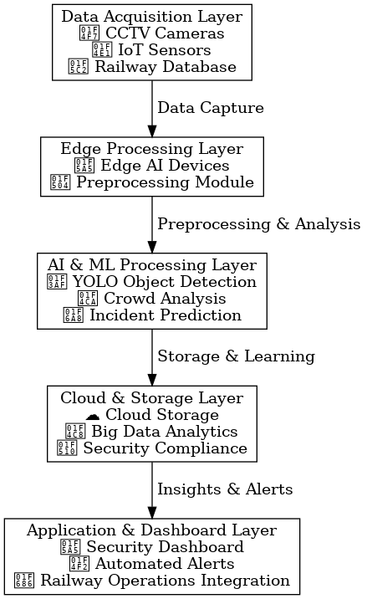
Architecture

Slide 9
Literature survey
Category | Study | Key Findings
AI-Based Crowd Management | P.R. Adithya et al. [1] | AI and ML analyze real-time CCTV footage to identify crowd dynamics and potential criminal activities.
 | Unspecified Study [2] | Automated framework enhances traditional surveillance using AI-driven methodologies.
 | Unspecified Study [3] | Enhancing existing CCTV systems by detecting crowd density and movement patterns for public safety.
 | Afnan Alazbah et al. [6] | Uses human crowd patterns and categorization for anomaly detection and threat identification.
AI for Crime Detection and Prevention | Shanle Yao et al. [4] | Smart Video Surveillance System provides real-time alerts while ensuring privacy using metadata-based activity recognition.
 | Sentinel Watch [8] | AI-driven crime prediction system using video-based violence detection and location-based crime classification.
 | Unspecified Study [9] | Application of deep CNNs and SVMs for crowd density evaluation and anomaly detection.
Work Monitoring and Situational Awareness | Mohammed Ameen et al. [7] | Analysis of automated crowd-monitoring systems using AI algorithms for public safety.
 | Babak Rahimi Ardabili et al. [5] | Data visualization techniques like occupancy indicators and heatmaps enhance ML-based video analytics.
Advancements in AI-Integrated CCTV Networks | Unspecified Studies [3,10] | Use of existing CCTV infrastructure for automated crowd counting, density estimation, and real-time suspicious activity detection.
 | Afnan Alazbah et al. [6] | Application of computer vision techniques to improve motion pattern analysis for threat assessment.

Slide 10
Github Link
The Github link provided should have public access permission.
Github Link

Slide 11
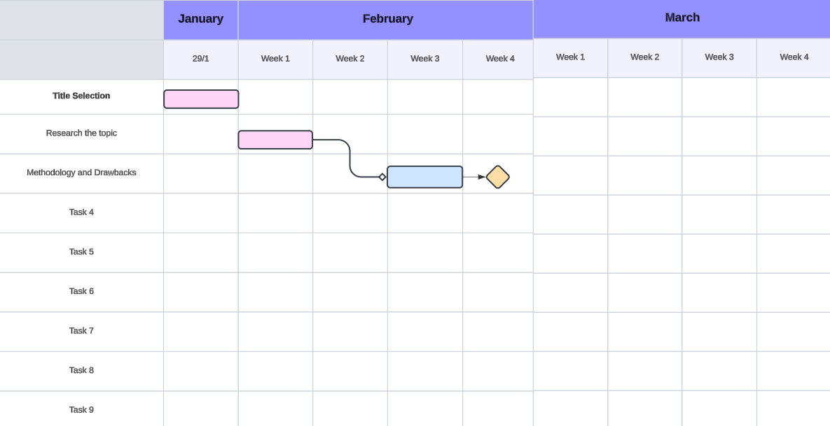
Timeline of the Project (Gantt Chart)

Slide 12
References (IEEE Paper format)
https://arxiv.org/abs/2311.12621
https://www.irjmets.com/uploadedfiles/paper//issue_11_november_2023/46461/final/fin_irjmets1700544371.pdf
https://ijarsct.co.in/Paper18135.pdf
https://www.researchgate.net/publication/260367543_A_network_optimization-based_approach_for_crowd_management_in_large_public_gatherings
https://www.publications.scrs.in/chapter/pdf/view/15
https://www.researchgate.net/publication/375599855_Crowd_Detection_Monitoring_and_Management_A_literature_Review

Slide 13


